Slide 1
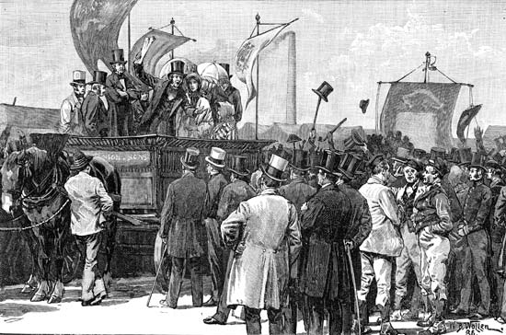
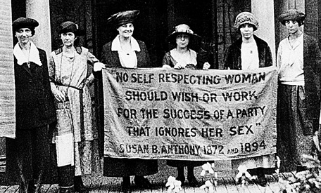
Rise of Liberal Democracy in Britain: 1780-1918 Illustrated Lecture for The History Society of Bharati College, DU by Dr. Devesh Vijay Associate Professor, Zakir Husain Delhi College, DU Date: 17-03-16
Chartists: Striving for Men’s Vote, 1840s
Suffragettes: Struggling for Women’s Vote, 1900s

Slide 2
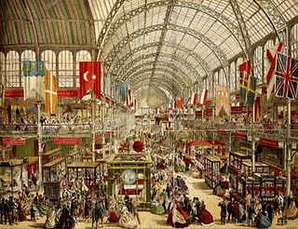
Major Features of Modern British History
1. Initiation of the Industrial Revolution
2. Largest Empire on Earth; Early Decolonisation
3. Early Growth of Constitutional Government, Rights, Democracy and Welfare
4. Major Role in Resisting Fascism and Axis Powers in World Wars
5. Outstanding Contributions in Science,
Literature, Social Thought, Sports etc.
6. Dark Side: Colonial exploitation; Ireland; Racism
The Crystal Palace Exhibition of First Industrial Products (1851, London)

Slide 3
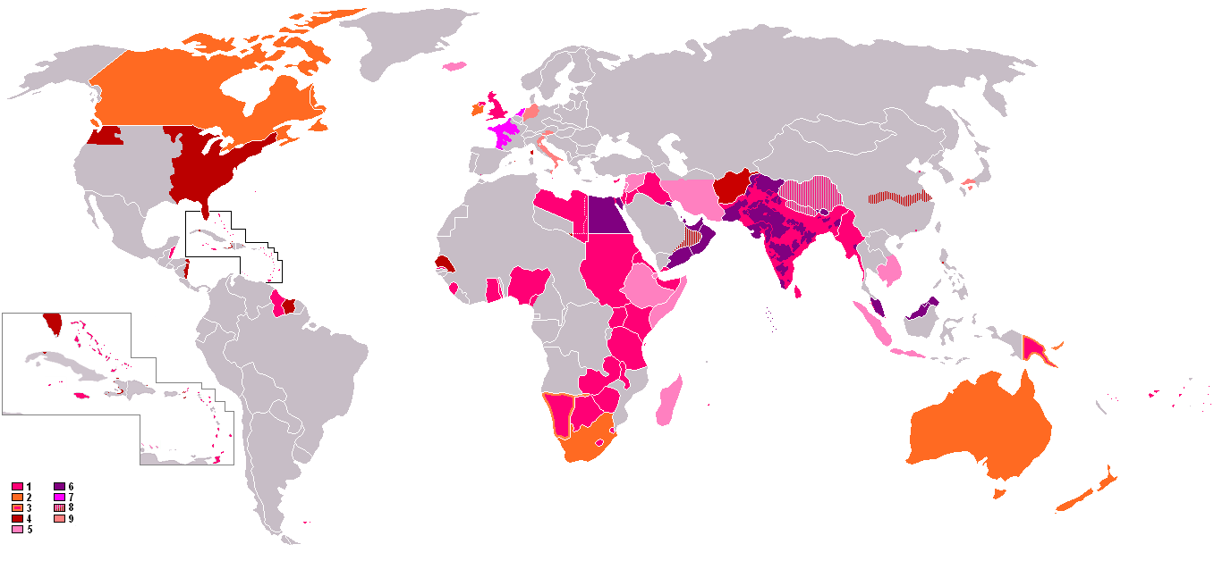
Points to Cover
Achievements of Modern Britain
Hallmarks of Liberal Democracy
Peculiarities of Britain’s Political Transition
An Analytical Approach to Political History
Peculiarities of 18th Century British State
Early Modern British Society
Problems in 18th Century British Polity Uniqueness of Victorian Improvements Steps in the Advancement of Democracy
Britain’s Spheres of Influence In Late 19th century

Slide 4
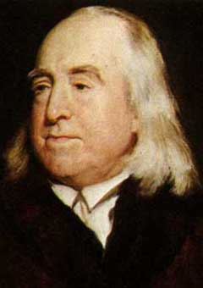
Additional Points
Administrative and Market Reforms
Towards Welfare
Nature of modern politics and state
Forces behind Political Change: Classes, Party and Ideology in 19th C
Liberal Demands in Late 18th Century Britain
Radical Demands of Early Working Class
Leaders and Middle Class Reformers
Working Class Organisations and Movements in Britain
Women’s Movements; Suffragettes
Sharp Duality in State’s Response till 1867
Chartists’ Demands and Achievements
The Reform Act of 1832: Principal
Provisions
Impact of the 1832 Act on Politics
Ideology of Welfare after 1867
Factors Behind ‘Reformism’ Exhibited by
British Workers
Factors Promoting Peaceful Democratic
Transition in Britain
Lessons for Us
Jeremy Bentham : Supporter for Adult Franchise

Slide 5
An Analytical Approach to Political History
Departure from Chronological Accounts of Politics and Politicians
Focus on Long Term Structural Changes
Thematic Survey of Incremental Reforms in 19th Century
Institutional History Followed by an Account of Social and Ideological Currents
Appreciation of both Exploitative and Exemplary Aspects of Britain’s Political Culture
E.J. Hobsbawm
Notes:
In the following pages, we shall try to understand the peculiar ways in which these competing tendencies evolved in 19th century Britain from two different angles: 1) as an institutional history of the modernisation of British state and administration between 1780 and 1914 and 2) as a survey of British politics or competition between parties and classes in the same era. In this manner, we hope to avoid reducing modern Britain’s political history to a record of various ministries and their immediate agendas and focus instead on long term structural changes in modern Britain’s political culture and institutions thematically. Thirdly, we also seek to avoid the pitfalls of both colonial (racial) and post colonial (generalised ‘early modern’) biases and to simultaneously focus on the critiques of corruption, manipulation and exploitation in modern Britain as also its remarkable liberal achievement that stands out specially in a comparative historical frame. We shall begin, however, by briefly reviewing the type of political institutions inherited by Britain at the close of the 18th century.

Slide 6
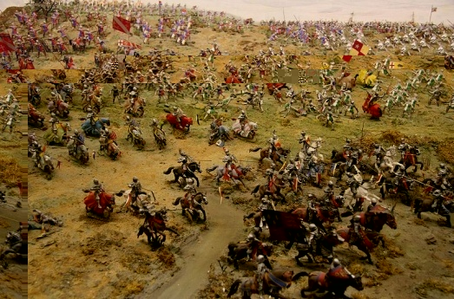
Preceding Feudal Monarchical System
Domination of Landed Aristocracy Extracting Surplus from Peasantry largely through coercion including torture.
Feudal and Ethnic Ties Important for Survival instead of Rule of Law.
Major Role of Religion and Churches.
Relatively Decentralised Authority though Absolutist
Monarchs began Suppressing
Feudal and Church Authority
5. A High Level of Violence
The Battle of Bosworth that Brought Henry VII to Power (A Recreation)
Notes:
Britain was among the first countries to emerge as a ‘nation state’ with a regular parliament (even before the Renaissance) through its prolonged rivalry with France in the ‘Hundred Years War’. Under the Tudors (16th century) and more so under the Hanoverians (18th century) Britain also acquired remarkable political stability with the cessation of internal wars amongst feudal factions, the creation of a strong defense against foreign invasions and considerable pride among its people for their expanding overseas empire as well as a `mixed constitution' at home consolidated through a substantial compromise between its landed and commercial elites in the twin revolutions of the seventeenth century.

Slide 7
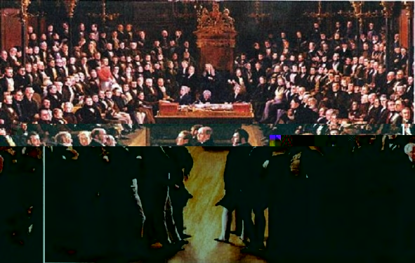
Nature of Modern Politics
1. Expansion of State’s Role and of Mass Organisations; Violent Instability Sought to be Replaced by Ideological Control.
2. Dictators Continue to Emerge through Military Might; But Greater Legitimacy is Accorded to Power Won through People’s Support.
3. This may Take the Form of Single Party Rule, Charismatic Leadership or Multi Party Electoral Contests.
4. Elections become the Principal Route to Political Power in Liberal States which may follow Presidential or Parliamentary Forms of Government
5. Ideology, Pursuation and Propaganda Play an Important Role in Such Contests.
More Destructive Weapons but also
More Professional Diplomacy and
International Peace Organisations
Political Violence is Formally Abjured by
Liberals; But Rightists as well as many
Leftists Accept Violence as Necessary
(with Radically Different Aims, of course).
Majority in Parliament: The New Route to Political Power Devised by 18th cen. Britain
Notes:
In the preceding section, we tried to summarise the evolution of the liberal ‘state’ in Britain over the ‘long nineteenth century’. In the following pages, we shall dwell more elaborately on the twists and turns of the ‘politics’ behind these constitutional and administrative changes as also the ideological conflicts which underlay this historic transition.
But before going over the major political tussles of 19th century Britain, it is relevant to recall that while ‘state’ is a structure and refers to a deeper order prevailing through a network of institutions in a territory, ‘politics’ is more of a process broadly referring to struggles for power of various kinds. Those who have power try to maintain it while those who are out of power may resist or try to capture it. In a sense, this tussle pervades all forms of social relations and institutions. At the level of the state, however, its intensity is particularly marked whether in the shape of factional clashes within the ruling classes or in wider struggles between the rich and the poor which may erupt overtly from time to time.
The modern period has witnessed significant transformations in the methods by which power has been sought and resisted by factions as well as classes in the state’s institutions. In traditional politics, the arbiter of power struggles was often seen in inherited customs or on the battlefield. The rising bourgeoisie in modern times has, however, favoured a more regulated order through a representative state which will facilitate maximum productivity and mobilisation of resources without giving up the basic inequality in the distribution of wealth and resources.

Slide 8
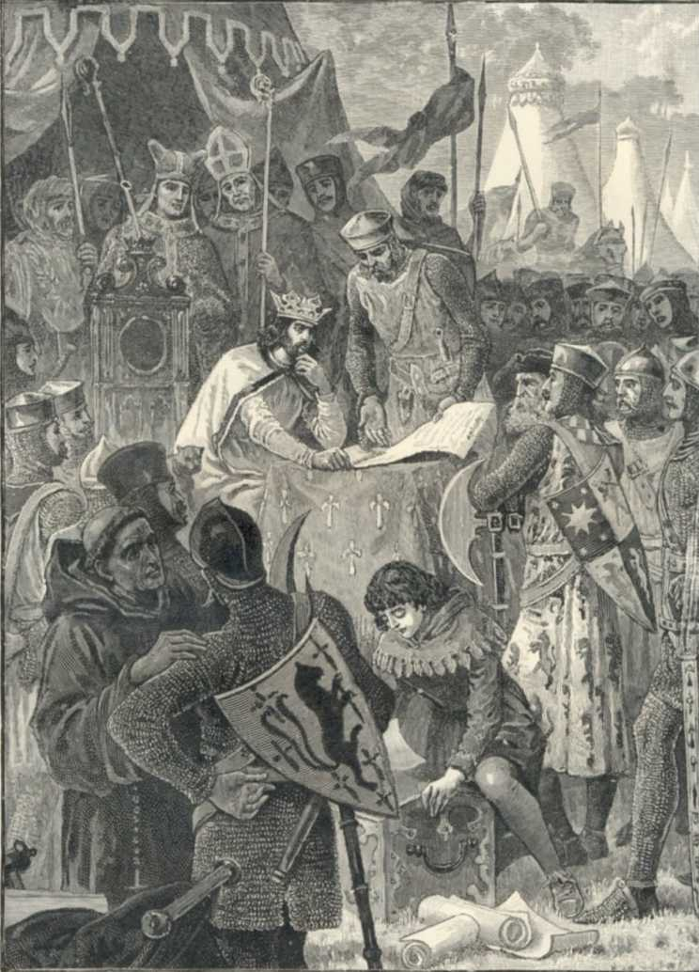
Hallmarks of Liberal Democracy
1. Restrictions on Monarchical, Feudal and Clerical Powers
2. Establishment of Constitutional Government (Rule of Law Equality before Law, Abolition of Torture)
3. Protection of ‘Freedoms’ or Individual Rights (including Private Property)
4. Separation of Powers; Checks and Balances between Organs of Government
Increased Power of Elected Legislature;
Extension of Voting Rights
Protection of Private
Wealth; Sharpening of
Economic Inequalities
Laissez Faire Substituted
with Growing State
Intervention and Welfare
in Later Liberal Thought
and Legislation
Magna Carta Birth of Parliamentary Government

Slide 9
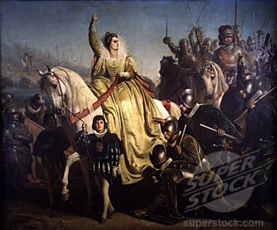
Peculiarities of 18th Century British State
Early Development of Nationalism and Sovereignty and Political Stability and Sturdy Defense
Centralisation of Administration and Suppression of Feudal, Clerical and Regional Authorities
Development of Parliamentary Checks on Monarchical Powers
A Powerful Judiciary Safeguarding Citizens’ Rights Like Habeus Corpus and Protection from Torture
Local Government Run through Justices of Peace in the Rural
Counties and through Mayors and
Councils in Urban Boroughs with
Relatively Little Police or Force
Rampant Corruption in Elections but
also Emerging Criticism of the Same
Foreign Travellers Considerably
Impressed by ‘Liberty’ Available
to British Press and Upper Classes
Elizabeth I Rousing Nationalist Fervour against Spanish Invasion
Notes:
The decline of widespread violence (in the form of factional wars within the ruling classes or large scale social unrest or brutal state suppression or even organised crime) in the 18th century was undoubtedly an outstanding feature of the 18th century British state and a vital foundation for its future accomplishments in the economic sphere too. But the most important aspect of the changing political culture of Britain was that the rising power of the state was accompanied also by the sovereign authority of the `King in Parliament' and a remarkable adherence to even unwritten political conventions and respect for constitutional checks put on the powers of the monarch, lords as well as ministers by the political settlements of 1660 and 1688-89

Slide 10
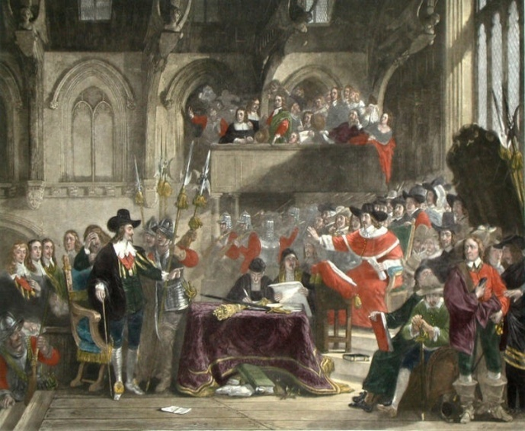
Outstanding Features of Early Modern British Society
1. Rapid Economic Growth in Agriculture, Trade and Modern Industry
2. Emerging Capitalist Relations in both Agriculture and Trade and Industry
3. A More Open and Compact Aristocracy and a Unique Gentry Class of Lesser Lords
Substantial Middle Class of Merchants
and Manufacturers
The Poor also better off than Peasants
and Workers in France, German Territory etc.
Elementary Social Security (beyond Charity)
A Gentleman Elite Investing in Learning
and Infrastructure
The Trial of Charles I before the Long Parliament
Notes:
While it is admitted that representative bodies played a unique role in Britain’s central as well as local government it should not be ignored that the dominance of the landed aristocracy at all levels was actually unassailable right uptil the beginning of the 20th century. However, the British aristocracy also had some unique characteristics which may be noted at this stage.
At the top, there was a powerful group of some 350 families who owned huge landed estates and were known by the titles of earls and squires. A seat in the House of Lords was their special privilege besides a hold on other influential offices of the state. Below this exclusive group of peers came the 4000 odd families constituting the British gentry. They were again owners of substantial landed estates. A few amongst them had wealth comparable to those of the Lords but their title was that of a knight or a baron and the offices they generally aspired to were those of the unpaid Justices of Peace or a seat in the House of Commons.
Another peculiar feature of the British aristocracy was its fairly compact character. While in most European nations the ruling elite was supposed to include all scions of noble families, in Britain on the other hand, due to the practice of primogeniture and the regular outflow of younger children of the bigger landowners into the armed forces, the diplomatic corps, the church and high finance, the number of titleholders remained fairly restricted even as some successful members from the trades and the professions could purchase estates and aspire for titles over time. Lastly, it may be noted that the cessation of feuds and intra-class violence within the British aristocracy, specially during the eighteenth century, was accompanied by the development of the gentlemanly ideal and increasing attention being paid to improvement of estates and to learning rather than to martial displays among this modern elite.These values and conventions evidently played a vital role in the economic and political success of the British state after the 17th century.

Slide 11
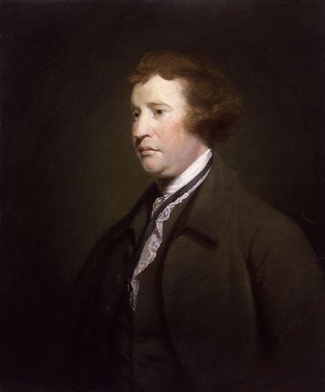
Cultural Peculiarities
Literacy Approaching 50%
Newspapers, Journals and Serialised Novels Growing Rapidly
A Developed Culture of Libraries, Reading Clubs etc.
Growth of Evangelist Missions along
with Greater Rights for Non Anglican
Religious Sects
5. Maturing Civil Society of Public Opinion,
Democratic Mobilisation and Associations
6. Spate of Remarkable Achievements
in Science, Literature, Technological
innovation and Modern Sports
Sir Edmund Burke (Champion of Conservatism and Probity in Politics)
Notes:
1.2.6 Cultural Developments
The cultural scenario in 18th century Britain, however, exhibited some remarkable features too. Literacy levels had already approached 50% of the population and universities such as Oxford, Cambridge and Edinburgh were making a mark in science and social thought through outstanding thinkers including Newton, Adam Smith, Hume etc. The press was not only relatively free but also growing even in smaller towns while London alone had more than 200 printing presses by 1780. The proverbial reading habit of the British was also becoming evident not only among the upper and middle classes but also in pubs and cafes thronged by artisans and workers.
The church had played a major role in spreading literacy and building schools all over Europe. But a very remarkable feature of the Anglican Church headed by the British monarch was that the rival Protestant sects had also been granted important rights though substantial religious equality specially with regard to the Catholics and the Jews was to emerge only in the nineteenth century. Evangelism or missionary activity for the spread of christianity was no doubt well organised and richly funded in Britain too; but it is equally notable that agnosticism and religious tolerance was also making advance in the country by the 18th century.
In fact, sub national identities were on the wane in early modern Britain. While the country never had caste divisions in the Indian sense, regional differences between the English, the Scots and the Welsh were also getting diluted under a strengthening British identity. (Though the prejudices and exploitation of the Irish Catholics and the colonial subjects in general remained undiminished throughout our period.)
Fourthly, a culture of civil associations, clubs and organisations dedicated to public causes was now building up a mature ‘public sphere’ in Britain of powerful public opinion and political activism.
Lastly, the fruits of growing education, press, tolerance and civility were also getting profusely evident in almost all fields of high culture. Indeed it is difficult to think of science without such English geniuses as Newton or literature without Shakespeare and the modern novel, or technology without James Watt, sports without cricket, tennis or football or even daily life without the flush toilet, metalled roads, railways and iron bridges all of which first made their appearance in Britain.

Slide 12
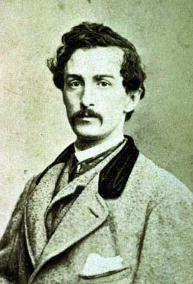
Advancement of Parliamentary Government and Civil Rights till the 18th Century
1. Land Setttlement of Normans 1066; continuing estates across centuries but paying taxes too.
2. 1215-- Magna Carta Signed to Acknowledge English Parliament’s Check on Monarch’s Authority
1265– First Elected House of Commons Called by King Edward
Habeus Corpus Writ (14th Century).
4. Evolution of Regular Parliamentary Say in Governance under the Tudors
5. Trial and Execution of King Charles I in the English Civil War
6. Passage of the Habeas Corpus Act in 1769.
7. 1688-89– Glorious Revolution and the Passage of the
Bill of Rights
8. 1770s-- Citizen’s Freedom from Arbitrary Arrest and
Newspapers’ Right to Report on Parliamentary
Proceedings Reiterated
9. 1780s--Restrictions on Crown’s Influence and
Evolution of Party Discipline and and Cabinet Govt.
John Wilkes : Struggle for Liberty
Notes:
The development of the cabinet system, the abolition of crown's patronage and influence on parliamentary proceedings, electoral reforms, and the evolution of political parties all passed through a crucial phase between 1780 and 1918. In most of these respects again, the gradual approach to change was maintained. Democratic reforms were introduced and franchise was progressively widened through important acts of parliament in 1832 (greater representation for emerging industrial towns in parliament), 1867 (vote for male urban working class), 1872 (institution of secret ballot), 1884 (vote for male rural workers), 1911 (supremacy of House of Commons in legislative sphere) and 1918 (voting rights for women).

Slide 13
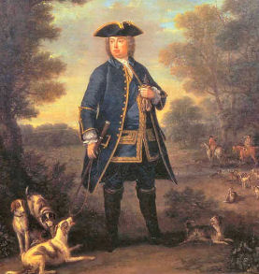
Major Drawbacks of 18th Century British Polity
Excessive State Bias Towards the Landed Aristocracy and Violent Suppression of Working Class Protests
Catastrophic Impact on Colonised Economies including Large Scale Slavery
No Voting Rights for the Poor,
Minorities and Women in Britain Itself;
4. Widespread Corruption, Discrimination
and Economic Monopolies in the
‘Mixed Constitution’ of 18th Century
5. Antiquated Demarcation of
Parliamentary Constituencies
Sir Robert Walpole (Whig Leader and Representative of New Wealth in 18thcentury Britain)
Notes:
Throughout the eighteenth century, however, maximum focus of the British state was on strengthening the agrarian gentry at the cost of independent farmers and laborers. The enclosure movement under which large estates were created by the rich for commercial farming out of the common land of the rural communities and by ousting the poor farmers was well supported by parliamentary legislation. On the other hand, the same parliament went to the extent of passing death penalties for petty offences such as hunting in the common lands or `theft' from forests etc. In order to firmly instil the awe of the propertied classes in the minds of the poor public hangings of such offenders was also prescribed. And those found guilty of the death penalty in eighteenth century Britain could well include children stealing goods above forty scillings or starving labourers trying to catch hare in the forests. Even Britain’s leading political thinkers from Hobbes and Locke to Bentham and Bagehot went out of their way to champion the sanctity of private property while the laws remained extremely harsh against the poor. The claims of `liberty’ obviously had little value for the ordinary folks of Britain.
Despite such limited growth of ‘liberty’, the British state in the eighteenth century could still not be described as modern in a true sense. It lacked a professional bureaucracy, police, fiscal and monetary systems and needed further development of a `free market', electoral reforms and extention of civil rights to minority groups such as the Catholics, workers and women. It also required a careful balancing of bureaucratisation with democratisation; centralisation with reform of local government and extention of civil liberties; the growth of the free market with social services and welfare schemes and, above all, new and more subtle ways of maintaining the state's ideological hegemony.It was the Victorian era which saw steady ‘improvements’ in many of these respects.

Slide 14
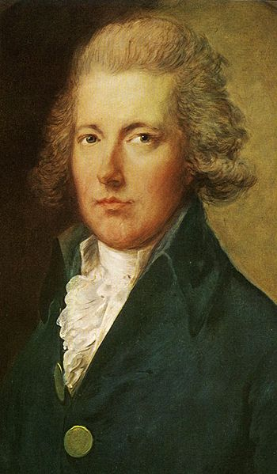
Growth of Parliamentary Democracy in 19th and 20th Centuries
Extention of Franchise through Reform Acts of 1832, 1867, 1884, 1918, 1928.
Unlike france and Germany, franchise brings real power to voters as House of Commons controls government.
2. Redistribution of Constituencies through Reform Acts of 1832, 1885 and 1948
3. Municipal Reform Act of 1835
4. 1872--Institution of Secret Ballot
1911—Acceptance of the
Supremacy of the House
of Commons over Lords
William Pitt the Younger

Slide 15
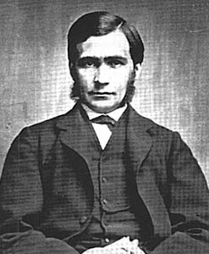
Evolution of Welfare in Britain despite Laissez Faire
1350—King Edward III’s Ordinance for Poor Regulating Prices and Wages
1601—Elizabethan Poor Law Formalizes Outdoor Relief through Parish Rates
1798—Introduction of Income Tax
1802—Health and Morals of Apprentices Act
1807– Prohibition of Slave Trade
1824---Anti Combination Act Repealed
1828---Corporation and Text Act Repealed
1829-- Catholic Emancipation Act
1833--First Factory Act
1833—Abolitaion of Slavery within
British Empire
T.H. Green
Notes:
Yet, the removal of traditional support systems such as poor relief had to be counterbalanced with new welfare measures through both central and local governments. Miserable conditions in new industrial cities and the growing demands of the working classes compelled the British state to reluctantly move in this direction even though the complacent bourgeoisie was still unwilling to give up early liberalism that opposed any state support for the victims of laissez fairist capitalism. In Britain, however, a good number of radical reformists emerged within the middle class also while most workers abjured calls for violent revolution. These twin movements of political moderation went a long way in preventing the extremes of right and left wing politics dominating the country of ‘improvements’ in its Victorian ‘high noon’.

Slide 16
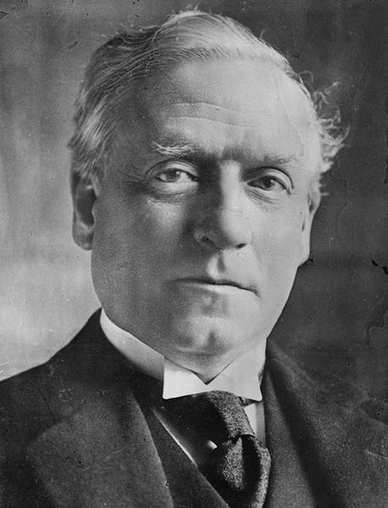
Evolution of Welfare in Britain: Gradual Change in Age of Improvements
11. 1833—Education Grants Introduced
12. 1842—Income tax Reintroduced
13. 1842—Mines Act
14. 1844/47—New Factory Acts
15. 1848—Central Board of Health Constituted
16. 1870—Foster’s Education Act
17. 1871—Trade Unions Recognized
18. 1876—Strikes Legalized
19. 1889—Dock Workers Win Minimum Wage
20. 1906—Trade Disputes Act Exempts Workers from Losses in Strikes
21. 1908—Old Age Pension and against Disability
23. 1945—Comprehensive Social Security and Welfare Benefits Guaranteed.
Architects of Modern Welfare H.H. Asquith
Notes:
Yet, as stated before, ‘improvements’ in most spheres came steadily but slowly in 19th century Britain. A beginning was made in the erection of a public education system with the Act of 1833 which provided for regular grants in aid to private schools while subjecting them to state inspection for maintaining standards in teaching. But disputes between religious groups slowed the pace of educational reform in Britain considerably. Similarly, public health policy evolved under Chadwick's energetic but controversial efforts at enforcing sanitation schemes through a public health board established in 1848. But gradualist and incremental rather than radical overhauls were preferred by the rulers in this vital field too. The development of public utilities was assigned to local bodies by the Municipal Reform Act of 1835. But momentum in this sphere also came from late 19th century when `gas and water socialism' was championed for electoral gains by leaders like Chamberlain.

Slide 17
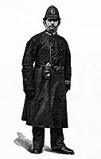
Administrative Reforms of the 19th Century
1. 1801—Union of British and Irish Parliaments
2. 1820s—Fiscal Reforms
3. 1823—Reform of the Penal Code
4. 1829—Creation of Modern Policing in London
5. 1830s—Prison Reforms
6. 1833 and 1870—Education Reforms
7. 1835—Municipal Bodies Reform
8. 1840—Penny Post Introduced
1868—Competitive Exams for
State Employees (only 50K in 1841 and 3 lakh in 1911 ag. 2 crore
in India today).
10. 1914--Irish Home Rule Bill Presented
Bobby or London’s Police
Notes:
Along with democratic governance, the overhauling of Britain’s administrationon was another major aspect of state modernisation attempted over the century. The leitmotif of the new administrative approach was centralised regulation and reordering through Commissions of Eenquiry and inspectors attached to each department at Westminster---the seat of Britain's government.

Slide 18
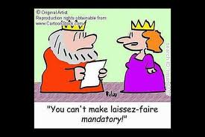
Market Reforms
1. 1773 Regulating Act Passed to Put Checks on the East India Company
2. 1786—Commercial Treaty with France
3. 1820s—Tariff Reduction
4. 1833 Trading Monopoly of East India Company Abolished
5. 1834—Poor Law Amended
1844—Companies Act and Bank
Charter Act
7. 1849—Repeal of Navigation Act
8. 1848—Repeal of Corn Laws
9. 1860—Cobden Chevalier treaty
A Satire on Free Trade Ideologues
Notes:
Another significant concern of the British middle class in the 19th century was the creation of an internally `free market' for rapid industrial development. The British state now adopted the aim of facilitating growth in the economy as a whole by providing a general climate of good governance and order and legal protection to property and contracts rather than support particular companies or business groups directly (as seen in countries like Russia, Italy and Japan). At the same time, laws and coercive apparatus was fully used to subjugate the growing labor force to the needs of capital.

Slide 19
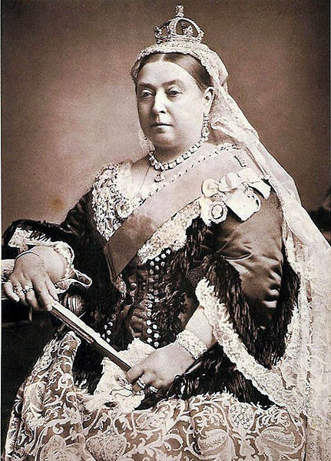
The Uniqueness of Victorian Improvements
Liberal Democratic Transition without a Violent Revolution of the Bourgeoisie or the Working Class (since 17th Century).
This was Particularly Striking in the Age of Repeated Revolutionary Outbreaks on the Continent
Measured but Cumulative Reforms in Extention of Vote, Factory Laws, Free trade, Health and Education etc. Called ‘The Age of Improvements’ or the Victorian Era
Democratic Reforms in Britain were Gradual and Incremental but
also Cumulative and Rarely Reversible.
5. No Dictatorial or Reactionary Reversal
Either
6. An Important Factor in British
Politics—Modern Conservatism Thwarted
any Radical Change and Esured the Formal
Survival of Institutions such as
Monarchy, Lords and Anglican Church
till Date.
7. The ruling classes realised the value of prospering workers and latter put faith in self help too.
Queen Victoria
Notes:
A characteristic feature of the modernisation of the British state in the Victorian era (1837-1901) was its slow and gradualist thrust. Unlike revolutionary France, or even conservative Germany, Britain did not go through violent political transformations or the sudden rise and fall of extreme ideologies/ groups in power. This, along with its parliamentary politics as we shall see below, helps to explain the relative absence of administrative watersheds of the type evident in Napoleonic France or Bismarckian Germany.
A close examination of the factory laws, electoral reforms and educational and public health schemes which were passed during the period as a whole reveals the same measured and incremental approach which the British parliament and political parties generally favored in administrative as well as market reforms. In this context, it may be useful to study the development of the modern state in Britain thematically rather than by tracing the various strands of administrative changes in a chronological order. The Whig reforms of 1830s (refer chronological table) were wide ranging but these again need to be understood in the broader perspective of measures initiated by the Tories in the preceeding decade and those continued by the government of Robert Peel later.

Slide 20
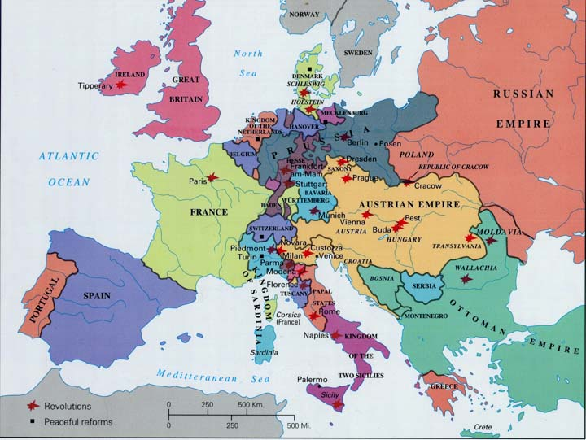
Peculiarities of Britain’s Political Transition
1. From Classical to Welfare Liberalism: State’s Harsh Attitude Towards Workers, Minorities and Women Replaced Gradually by accommodative Welfare
2. In many Cases such as Abolition of Slavery, Introduction of Income Tax, Factory Laws etc. Britain Proved to be a Pioneer and Model for other Liberal States.
3. However, Liberal Reforms at Home were Seldom Translated into Colonial Relief (including Ireland) till the Era of World Wars.
A Quiet Britain in the Age of Revolution (1848)
Notes:
As noted before, the history of modern Britain offers an outstanding case of a stable polity which underwent liberal democratic transformation without a violent overthrow of its aristocracy or, later the bourgeoisie. This was in marked contrast to most countries on the Europeon continent which saw frequent outbreaks against feudal regimes and their successor bourgeois states as well. On the other hand, the British Isles (apart from Ireland) were transformed in this `Age of Revolutions' more by ‘improvement’ than by revolts or violent upheav

Slide 21
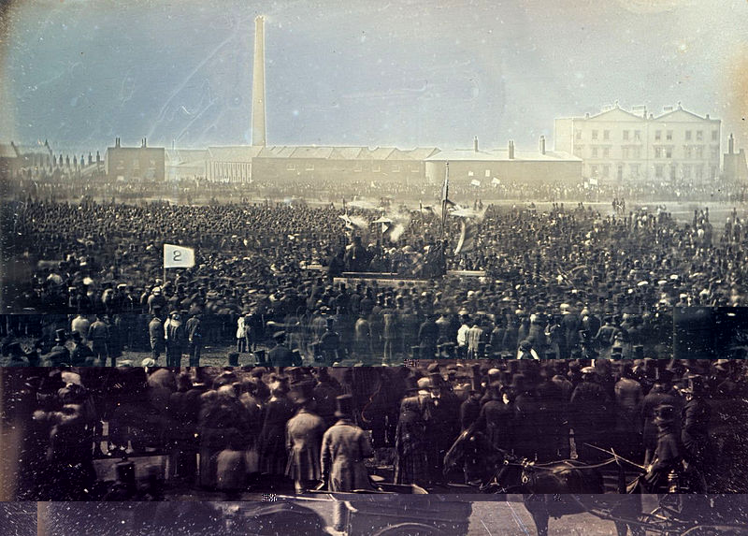
New Social Forces in 19th Century British Politics
An Expanding and Well Organised Educated Middle Class
Growth of a Public Sphere Fuelled specially by Middle Class Radicals
Birth of a Massive Industrial Working Class
Rise of Trade Unions and other Labor Organisations
Irish Secessionism
The Chartist Meeting at Kenningston Common
Notes:
Throughout the eighteenth century, Britain saw considerable expansion of population as well as agricultural production and trade and commerce. Such sustained economic growth in turn unleashed new social and political forces by the close of the century. England, Scotland as well as Wales were getting rapidly urbanised and witnessing the rise of a new social order dominated by the middle and working classes in place of the old clergy, lords and agricultural workers. Moreover, the relations between the new social groups were qualitatively different from those of the old. A much greater degree of competition and conflict informed the relations between these classes as deference or acceptance of hierarchical differences were now on the decline. In the following pages, we shall dwell at length on the liberal politics favored by most members of the rising middle class in Britain and the democratic tendencies propelled more by the workers and the radicals in succession

Slide 22
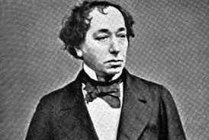
Major Ideological Currents of 19th Century
Modern Conservatism
Liberalism
Radical Reformism
Utilitarianism
Utopian Socialism
Reformist Labor Party
Feminism
Marginalised Communism
Benjamin Disraeli: Proponent of Reformist Conservatism

Slide 23
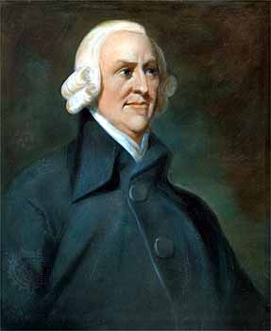
Liberal Demands in Late 18th Century Britain
Checks on Monarchical Influence in Gover- nment
Guarantees for Free Press and Safeguards against Arbitrary Arrests
Elected House of Commons’ Control on the Executive’s Spending
Free Trade Measures including Tariffs Reduction and Abolition of Monopolies
Greater Representation for New Industrial
Centers and Extention of Franchise to
Non –Aristocratic Elites Also
6. Increased ‘Disciplining’ of the Poor
Specially with Regard to
Unemployment Relief, Irreligion,
Alcoholism and Education
Adam Smith
Notes:
Britain had a tradition of liberal thought going back to the revolutionary decades when philosophers such as John Locke had espoused a new theory of state bound to safeguard persons and property. The new controversies generated by the Wilkes' case centring on the freedom of press and protection against arbitrary arrest during 1760s and 70s further brought the issues of civic rights centre stage in British politics. The formation of the ‘Society for the Defence of Bill of Rights’ in 1769 and the ‘Society for Constitutional Information’ in 1780 gave organised shape to such struggles. The arrogance of George III, who ruled Britain from 1760 to 1820, the fight for liberal rights led by leaders such as Fox and Wilkes and issues raised by the liberation of British colonies in America after 1776 further stoked the embers of liberal protests so that the last decades of the eighteenth century were marked demands for restrictions on undue monarchical influence in the working of the parliament and also against the violation of individual liberty by the government.

Slide 24
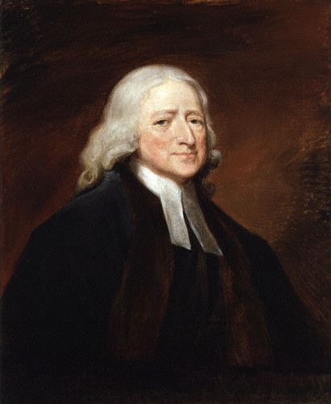
Radical Demands Championed by Early Working Class Leaders and Middle Class Reformers
Abolition of Slavery and Liberation for the American Colonies
Universal Male Franchise
Utilitarian Reforms in Penal Codes, Poor Relief, Factory Laws, Health and Education etc.
Abolition of Monarchy as well as the House of Lords
Workers’ Partnership in Management and Profits
Setting up of New Egalitarian Communities and
Workers’ Cooperatives
7. Voting Right for Women Championed by a
Few Feminists before the Suffragette Movement
John Wesley:
Proponent of Methodism
Notes:
The demand for more radical electoral and parliamentary reforms was, meanwhile, gaining momentum amongst artisans and working classes supported by sections of the middle class as well. The writings of radicals like Tom Paine and Major Cartwright acted as powerful catalysts in this respect. The outbreak of the French Revolution in 1789 also had a positive impact initially on the radical movement in Britain as it revived the interest in democratic reforms which had been marginalised after the infamous Gordon riots against Catholics in London in 1780. The Society for Constitutional Information was now revived along with the opening of a number of Republican Clubs in the provinces. One of the most radical of these was the London Corresponding Society which under the guidance of the London shoe maker--Thomas Hardy sought to organise a nationwide protest for parliamentary reform as well as workers' rights and also established contacts with the Revolutionary Convention in France.

Slide 25
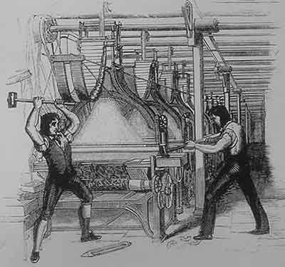
Major Working Class Movements in Britain
Food Riots against High Prices and Profiteering
Luddism or Attacks on New Machinery by Jobless
Friendly Societies and Cooperatives for Self Help
Early (Unrecognized) Trade Unions and Strikes
Utopian Socialist Experiments
Revolutionary Societies and
Orgnaisations such as the
International Working Men’s
Association
7. Chartist Movement
8. New Unionism by Unskilled
Workers and their Own Leaders
9. Formation of the Labor Party
10. Marginalisation of Revolutionary
Organisations
The Luddites (A Representation)
Notes:
Meanwhile the working class movement was also maturing in Britain. The initial phase of industrialisation was full of misery for the proletariat which worked and lived in extremely hostile conditions for long hours on meagre wages and with few rights or social security. It is hardly surprising that in the face of these brutal conditions, in several places, the workers responded by systematically breaking new machines which symbolised the capitalist order to them. These early machine breakers have been nicknamed Luddites after their mythical leader Nedd Ludd.

Slide 26
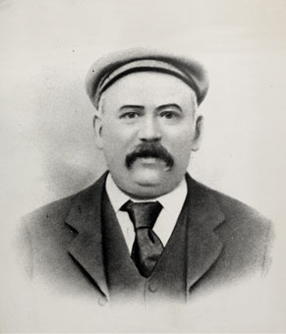
Specific Working Class Protests of the 19th Century
Radical Movements as that of the Spenceans and the Owenites for Redistribution of Land and Workers’ Control over Factories
Reformist Movements as those of Tolpuddle Martyrs for Better Wages and the Right to Strike
The Grand National Congress of Trade Unions (GNCTU) Demanding Ten Hour Working Day and the Call for a
General Strike
4. London Working Men’s Association
Demanding Universal Male Franchise
5. Chartist Petitions Carrying Millions
of Signatures Demanding Comprehensive
Democratic Reforms
Thomas Spence : A Champion of Equal Distribution of Land
Notes:
The defeat of Napoleon at Waterloo in 1815 had been celebrated all over Britain. However, for the workers of Manchester and Birmingham who were awaiting reforms, the end of the war actually brought more unemployment and economic difficulties. Yet, the Tory government of Lord Liverpool (1812-27) increased its repressive policies. The `March of the Blanketeers' which was led towards London by the weavers of Manchester to protest against their sufferings, in 1816, was beaten back. The revolt of the Spenceans who asked for redistribution of land, was, of course, shown as treason and crushed. 

Slide 27
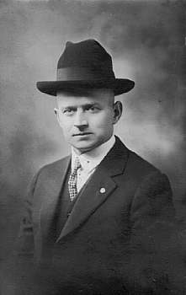
Chartists’ Demands
Universal Manhood Suffrage
Secret Ballot
Annual Parliaments
Equal Electoral Districts
Abolition of Property Qualification for
Members of Parliament
6. Regular Salaries to MPs
ACHIEVEMENTS
Though All Chartist Petitions were Turned Down by Britain’s Parliament, the Movement was not without Important Consequences:-
It Provided a Major Fillip to Unionisation of Labor in Britain
It Expressed British Workers’ Faith in Parliamentary Methods
Almost All Chartist Demands were Met by Early 20th Century
Smith o’ Brien : A Chartist Leader
Notes:
While the differences between the aristocracy and the rising bourgeoisie could be reconciled after the Reform Act of 1832, the same could not be said for the more serious clash between the workers and the upper classes as a whole. Indeed, the laboring classes were quick to realise that a parliament which rests on limited franchise linked to the ownership of property will never be sympathetic to their sufferings. As a result, many turned towards the creation of non parliamentary institutions such as an independent workers’ convention, cooperatives or to radical demands for universal franchise, secret ballot and stipends for all members of parliament. A few even propagated the redistribution of land, workers control on factories and a socialist order more generally which would rest on the collective ideals of equality rather than economic competition between individuals.
The upper classes, however, were determined to thwart all such demands in order to extract a heavy price from labour for the rapid development of capital in the initial phase of industrialisation. We have talked about the radical movements led jointly by artisans and some middle class activists at the turn of the nineteenth century as well as the repressive measures undertaken against them by the British state culminating in the Peterloo massacre of 1819. During the same period, an independent and vibrant working class movement with its own friendly societies, cooperatives, newspapers and stores as well as trade unions was also coming into being in Britain. It was distinct from the earlier 18th century radical tradition by virtue of its own proletarian leadership (substituting earlier mainly middle class leaders, an independent agenda of economic demands and more sustained organisation now.

Slide 28
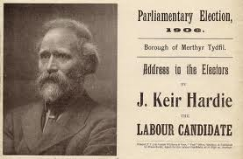
Factors Behind ‘Reformism’ Exhibited by British Workers
The Institution of Free Speech and Parliamentary Reforms Provided a Safety Valve to Workers’ Discontent in Britain
Rapid Economic Growth Facilitated Higher Standard of Living for a Chunk of British Workers
The Economic Benefits of the Largest Empire and Trading Country Extended Partly to Workers Also.
The Role Played by Labor Aristocracy or
Reformist Upper Strata of Skilled Workers
5. Transition from Harsh Laissez Faire to
Increased State Intervention in Late
19th Century
6. Regular Appearance of Pro Poor Radicals
among British Upper Classes in the Period
7. The Ideology of the Empire and
Popular Nationalism also Kept Workers
Loyal to British State
8. Failures of Utopian Socialism
Election Poster of Labour Candidate: Kier Hardie : Workers’ Power through Parliament
Notes:
None of these measures removed the basic inequalities in Britain’s social structure as the sanctity of private and inherited property was never challenged. In fact, fresh bouts of agitation after the first world war and the gargantuan crisis of ‘The Great Depression’ would have to intervene before Britain’s liberal polity would really fulfil these fundamental aspirations of workers and of the `second sex'.Yet, a crucial benchmark had been crossed in Britain by late nineteenth century with the largely peaceful resolution of the class question thrown up by the Chartist movement and socialism. The acceptance of the parliament and electoral politics as the central mechanism for the resolution of all social and political conflicts was the key to this evolving order.

Slide 29
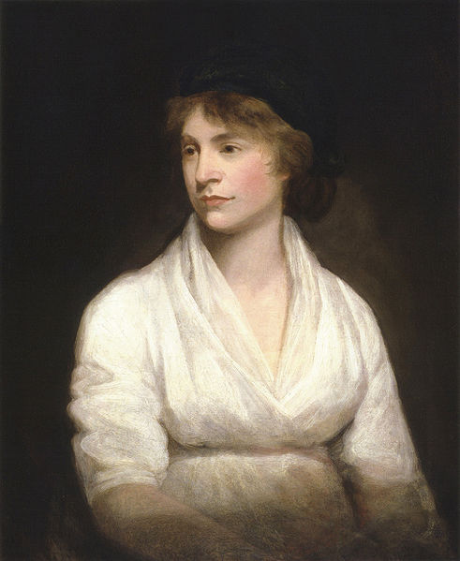
Women and Men Feminists
Early Feminist Writers
Women’s Entry in Modern Industry and Services as well as Higher Education on a Large Scale
The Suffragettes Movement for Women’s Political Rights
John Stuart Mill Mary Wollstonecraft

Slide 30
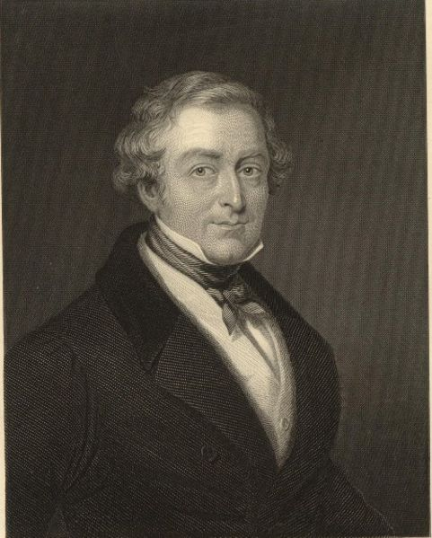
Duality in State’s Response to Middle Class and Working Class Demands
1. Middle Class Demands Accepted through Measures such as Tariff Reforms, Extention of Franchise to Industrial Centres in 1832, Abolition of Corn Laws, Passage of the New and Stricter Poor Law etc.
On the Other Hand, Workers’ Protests were Brutally Suppressed in the Early 19th Century as Evident in the
Peterloo Massacre, Tolpuddle Martyrs’
Case, the Blanketeers’ March,
Prosecution of Spenceans and the
Rejection of all Chartist Petitions.
3. However, Some Radical Demands such
as Universal Adult Franchise and
disempowerment of the Monarchy as
well as the House of Lords Materialised
with Time along with the Evolution of
a Welfare Machinery for All.
Sir Robert Peel : Builders of Political Consensus and Accomodation
Notes:
British state responded to these liberal and radical demands in very different ways. Some economic and administrative reforms were accepted to accommodate the aspirations of the rising middle class. Indeed such `reformist conservatism' of the British oligarchy distinguished it clearly from the `rightist' forces in most Continental regimes of the period and helped in forging an early alliance between the aristocracy and the bourgeoisie subsequently. But the demands of the workers were viewed with general suspicion and suppressed unequivocally in the initial years of industrialisation.

Slide 31
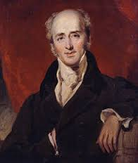
The Reform Act of 1832: Principal Provisions
1. Abolition of 143 Rotten Boroughs Seats in England (None in Wales).
2. Creation of 135 New Seats for England and Wales (including 65 New County Seats and 65 New Urban Seats in England and Four in Wales)
3. Extention of Franchise in both Counties and Boroughs (but Only for Men)
A Total of Six Lakh Men or 3% of Britain’s
Population Came to be franchised by
the Act. This was Almost Double the
Number of Voters in Britain before 1832.
5. Similar Reform Acts were Soon Passed
for Scotland and Ireland Too.
6. Total No. of Seats in U.K’s. House of
Commons Remained Roughly the Same.
Lord grey (1764-1845)
Notes:
The passage of the Parliamentary Reform Act of 1832 was one of the most crucial events in Britain's transition to modern politics as it ensured a prominent place to the rising middle class in the British polity and a stake in its stability.
Demands for reform in Britain's old parliamentary system had been growing with industrialisation since late eighteenth century. A number of bills had been introduced in the parliament, especially since 1780s, to enhance the representation of the new industrial centres. But none gathered sufficient support. While radicals under the leadership of Burdett and some Whig leaders such as Brougham and Russell were committed to reform, the ruling Tories were dead against any constitutional innovation. Both the major parliamentary factions were, moreover, united in dismissing democracy or a radical extention of the franchise as dangerous for the country. 
The accession of the liberal monarch William IV in 1830 brought the Whigs to power after a long gap. This brightened the chances of limited parliamentary reform. The same year revolutions also broke out in a number of countries in Europe and gave further filip to reform efforts in Britain. Under such pressures, the House of Commons passed two successive reform bills. But both were thrown out by the House of Lords. Meanwhile, pro reform associations were formed in several cities of Britain and leaders like Thomas Attwood in Birmingham and Francis Place in London tried to mobilise shopkeepers, artisans as well as workers in support of electoral reform. In the elections of 1831 which were called to end the deadlock in parliament, the reformist Whigs were again returned in majority. Ultimately, the House of Lords also bowed before the ‘liberal’ king's warning of creating new reformist peers and the first Reform Act thus came into force in 1832.

Slide 32
Impact of the 1832 Act on Politics & Parliament
Inclusion of Rising Middle Classes in the Parliamentary Process
Enabling a Peaceful Resolution of the Bourgeois Challenge to Aristocratic Rule in Britain
Workers Aspiration for Vote Defeated
However, Increased Reformist Trend in the House of Commons after 1832 Accelerated Victorian Improvements in Spheres of Health, Education etc.
A Radical Recasting of Party Structures
among Both Whigs and Tories (Now
Called Liberals and Conservatives
Respectively)
6. Greater Check on Electoral Malpractices
and Evolution of Constitutional
Conventions for Governing as well
as Opposition Groups
William Morris : Poet and Reformer
Notes:
The aim of the Act, however, was to preserve the existing Constitution of Britain; not to change it. For this it tried to introduce some reforms in the election of the House of Commons. While providing for a redistribution of 143 seats of the lower House to accord with the new demographic pattern of industrial Britain, the Act also abolished a number of `rotten' boroughs and extended the franchise marginally in the counties and the boroughs. In the counties, all men who were £10 copyholders and £50 ‘tenants at will', in addition to the 40 shilling freeholders, now obtained voting right. In the boroughs, on the other hand, all householders occupying residences worth #10 per annum or more were enfranchised. The new electorate still consisted of less than six lakh men or a mere 3% of the total population of Britain then. 
Thus, the Act of 1832 ensured that the rule of property would continue in Britain. But, alongside the established aristocracy, it granted representation to the rising middle classes in the country’s parliamentary government. This went a long way in forging a compromise between the bourgeoisie and the landed elite. Thus it enables a peaceful transition to a liberal polity in Britain.
Apart from redefining the class character of the state, the Act had some other long term implications which are important to note at this stage. Firstly, the very manner of its passage enhanced the significance of the House of Commons in relation to the upper House and also set an important precedent of extra parliamentary pressures on legislators. Secondly, the reformist agenda within parliament became extremely strong after 1832 as more radicals entered parliament from the industrial centres which had gained representation and the Whigs and the Tories were also forced to develop new programs to broaden their appeal amongst the middle classes The new members of parliament were also exposed to greater pressure both from the constituencies as well as the parties. In the preceding section we have noted a host of reforms including factory laws, municipal reform and the freeing of the labor market through a new Poor Law which were passed by the parliament soon after the Reform Act of 1832. 

Slide 33
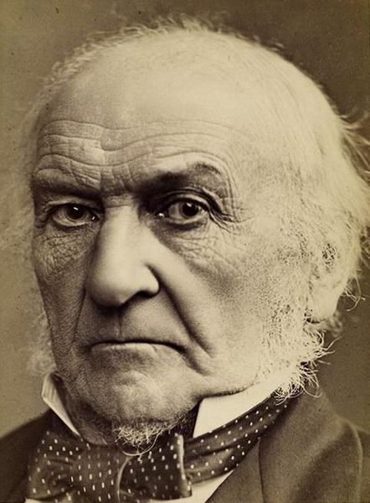
Factors that Promoted A Peaceful Democratic Transition in Britain
Creation of the ‘Mixed Constitution’ Allowing Elected Representatives and Parliament Regular Say in Governance
The Importance of Rule of Law on the Notion of Citizen Rights Protected by Fairley Independent Courts in Britain
Colonial Spoils’ Contribution to Higher Standards of Living for the British Working Class Also
Early Compromise Arrived at between
Landed Aristocracy and Rising Bourgeoisie
as Evident in the 1832 Reform Act and
the Repeal of Corn Laws
5. Reformism in Place of Revolution Preferred
by the British Working Class
6. The Tradition of Moderation, Pragmatism and
Cumulative Reform in British Political Culture
Gladstone : A Champion of Political Conventions and Morality
Notes:
Factors which led to a successful resolution of class struggles in the first industrial nation were: the unity displayed by its upper classes vis a vis workers, the economic benefits of the expanding British Empire, the relative weakness of revolutionary politics in nineteenth century Britain and the slow but steady growth of welfare legislation under the Liberal as well as the Conservative regimes. A deeper understanding of a stable liberal polity such as Britain’s requires a special focus on its ideological apparatus too. Propaganda is not peculiar to modern times. Earlier states also sought legitimacy through religious sanctions and by patronising the traditional intelligentsia. In modern times, however, the search for legitimacy and thought control can be more subtle and indirect. National education and state awards and the subtle regulation of modern media offer important channels for such control.

Slide 34
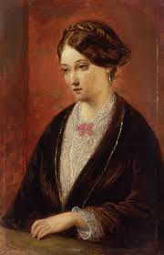
Some Lessons
Democracy does not have to be Chaotic or Weak (as Charged by its Fascist Critics)
Respect for Laws, Rules, Conventions and Institutions among all Classes Crucial for Democratic Functioning
Role of Pro Poor Radicals among the Upper Classes and of Moderates among the Lower Classes Required
Timely and Continuous Reforms
Necessary along with Economic Prosperity
Acceptance of Parliament as the Forum
for Resolving All Disputes
6. Competition between Parties can Throw
Up More Radical Twists than Intended
by Rulers
7. Real Social Equity not Realised by Welfare Liberal Order too. Florence Nightingale: A Life dedicated to Service of the Sick
Notes:
At the same time, we must admit that a memorable aspect of nineteenth century British polity was that the numerous ‘improvements’ in laws, administration, budgeting and welfare etc, tiny and cautious though they were, rarely suffered reversion or circulatory swings over time. As a result, the British reform experience was limited but steady and cumulative. It is also memorable that even in the middle ages, the Magna Carta, signed by a cornered King John (in 1215) was never reverted by the most powerful of British monarchs also. Countries where enquiry commissions and social reformers keep going over and over the same suggestions and measures while problems ranging from poverty to unemployment to corruption remain almost unshaken, have a lot to learn from the history of Britain’s political culture.
The rise of liberal democracy in nineteenth century Britain constitutes a major landmark in the history of the modern world as a whole. At the beginning of the twenty first century when the revolutionary legacy of France, Russia and China are being reassessed by revisionist historians comprehensively, a critical look at the alternate route to modern politics pursued in Britain becomes even more relevant for students of history. Among the factors which facilitated the relatively peaceful transition (barring the Irish question) to a liberal polity in Britain mention must be made of the nature of the mixed constitution already existing by the end of seventeenth century, the politics of accomodation followed by the aristocracy as well as the bourgeoisie specially after mid nineteenth century and of reformism preferred by British labor and also the benefits of the largest ever empire which could keep the labor aristocracy more contented in Britain than in France, Italy or Germany, Russia etc.

Slide 35
References
A.J.P. Taylor, English History, 1914-1945, 1965.
Albert Goodwin, The Friends of Liberty: The English Democratic Movement in the Age of
French Revolution, Cambridge, 1979.
Asa Briggs, The Age of Improvement: 1783-1867, 1959.
E.J. Hobsbawm, Labourng Men, Verso, 1979.
E.P. Thompson, The Making of the English Working Class, Pantheon, N.Y., 1964.
Michael Bentlley, Politics without Democracy, Basil Blackwell, 1984.
8. Michael Willis, Democracy and the State: 1830-1945, Cambridge University Press, 1999.
9. Raymond Williams, The Long Revolution, Greenwood Press, 1961. Pp.156-171.
10. Robert Owen, A New View of Society, London, 1813. A proposed utopian society
11. T.A. Jenkins, The Liberal Ascendancy: 1830-1886, 1994.
12. T.O. Lloyd, Empire, Welfare State and Europe: English History: 1906-1992, 1976.

Slide 36
Web References
Web Links:-
www.historywiz.com (for primary sources)
www.openuniversity.ac.uk
powerpointpalooza.net (for powerpoint lectures)
bbc.co.uk/history (for alternative lessons)
For Related Films and Audio Resources:-
www.youtube.com/watch?v=Ln58d-K17XY (For: Tale of Two Cities Film based on Dicken’s Novel)
www.youtube.com/watch?v= (For Videos on Disraeli and Gladstone)

